Slide 1

Projectile Catching with Reinforcement Learning: Empirical Analysis using Discretized Simulations
Bryon Kucharski, Adam Ziel, Michael Hickey, Collin Travers
Wentworth Institute of Technology
2018 IEEE MIT Undergraduate Research Technology Conference
Cambridge, MA
Real-World Projectile Catching with Reinforcement Learning: Empirical Analysis using Discretized Simulations

Slide 2
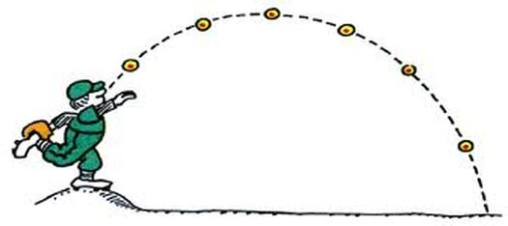
Motivation
Senior Design Project
How could a robot learn to catch a ball?
Trajectory Planning
Kinematic equations – Kober [1]
Supervised learning – Lampariello [2]
Notes:
Wanted it to learn and not directly calculate the landing location
Didn’t want to use supervised learning and create a dataset
Used Reinforcement learning
*We aren’t focused on how a robot hand could correctly catch a projectile,
we are concered with how a robot could learn the trajectory of the ball and move the the right landing location
Step 1 was to create a way to have this projectile path

Slide 3
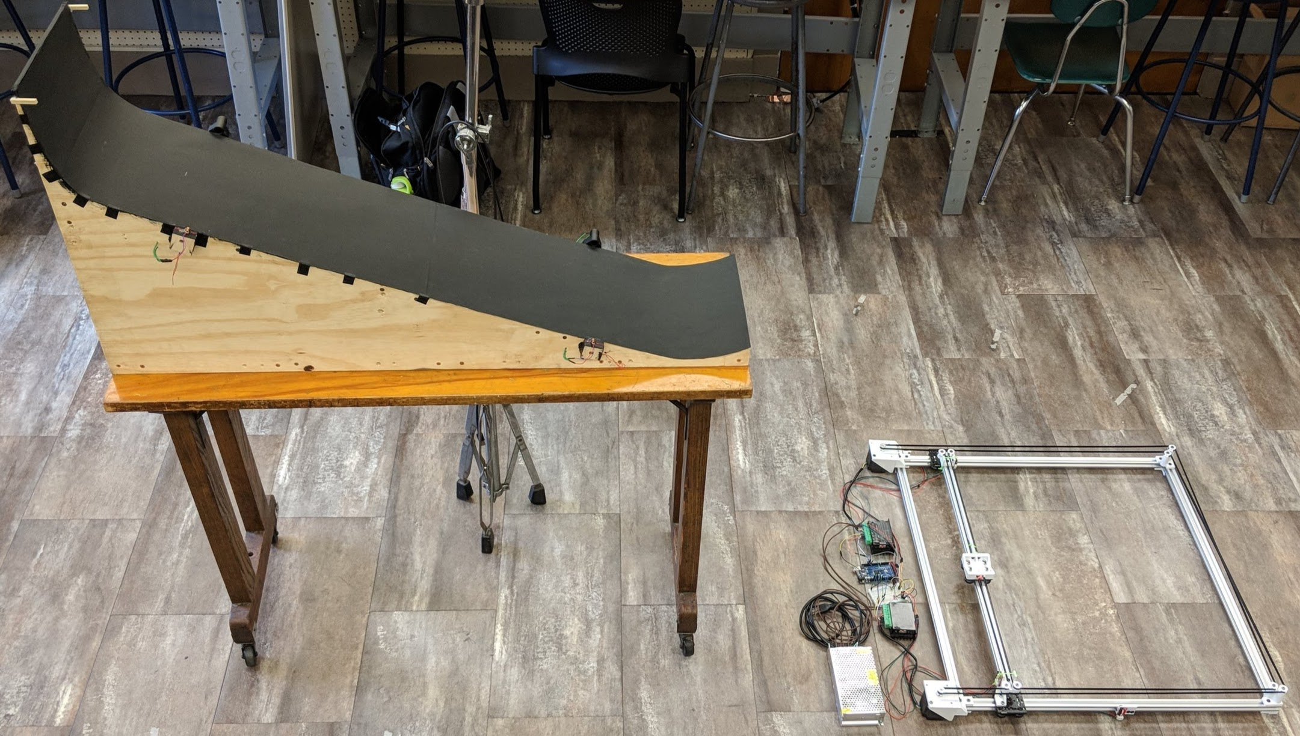
Real World Environment
Controllable Environment
Different launch angles
Repeatable Results
2D Gantry Robot
Notes:
Incline and ramp angles were carefully tested

Slide 4
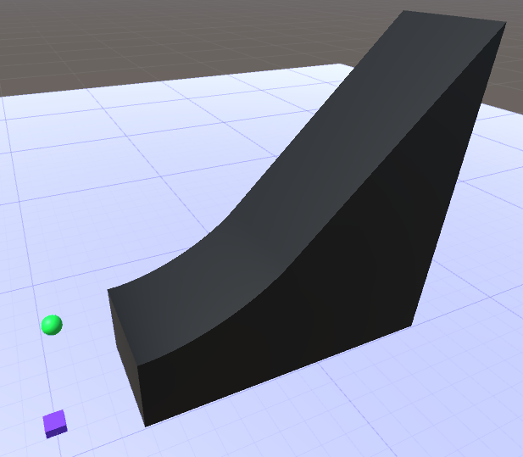
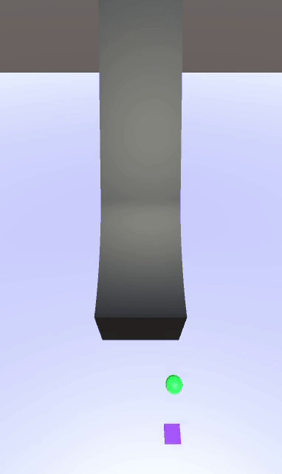
Simulation
Notes:
This is what that looked like in simulation
This paper is about using this simulation to compare alrogithms

Slide 5
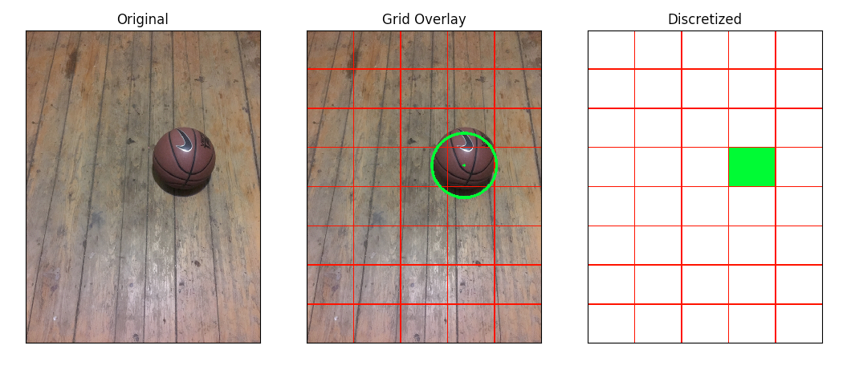
Discretization
Continuous to discrete
Computationally feasible
Sacrifice accuracy proportional to level of discretiziation
Notes:
Key factor in our design to get it to work
400x400 images to 5x8 image

Slide 6

Reinforcement Learning (RL)
“Learning what to do—how to map situations to actions—so as to maximize a numerical reward signal” – Richard Sutton and Andrew Barto [3]
Notes:
Once we have the environment set up how does the robot actually learn?

Slide 7
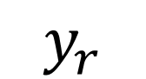
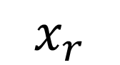
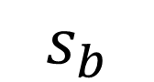
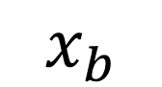
RL for Projectile Catching
$$x_{b}$$
State: ball’s lateral position
ball’s speed
robot x position
robot y position
Action: left, right, forward, backward or stay
$$s_{b}$$
$$x_{r}$$
$$y_{r}$$

Slide 8
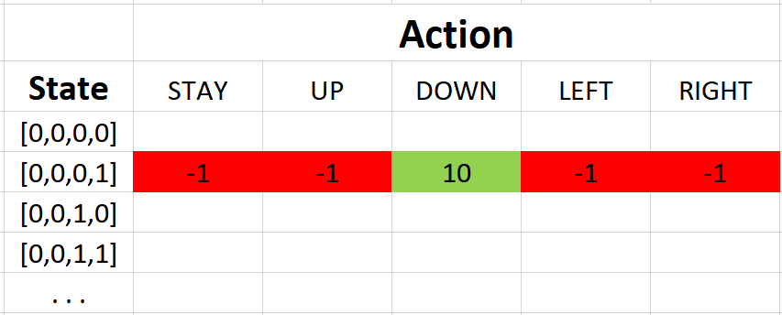
Q-Value and Q-Learning
Q-Value
Value of taking an action in a current state
Q-Learning - Sutton and Barto [3]
Algorithm that converges to the optimal actions to take in every state
Q-Values are stored in a table
Q-Values are updated as the agent interacts with the environment
Actions are selected by picking the highest Q Value for the state
learning rate
discount factor
Notes:
How good is it to take an action a in state s at time t
Alpha is the learning rate
Gamma is a discount factor, or how far in advance to you care about rewards
Gamma of 1 – I care about all rewards equally the same
Gamma of 0 – I care about immediate rewards a lot more
We set this value to 0
Its inpaper, but we care about immediate reward only b/c of reward function

Slide 9
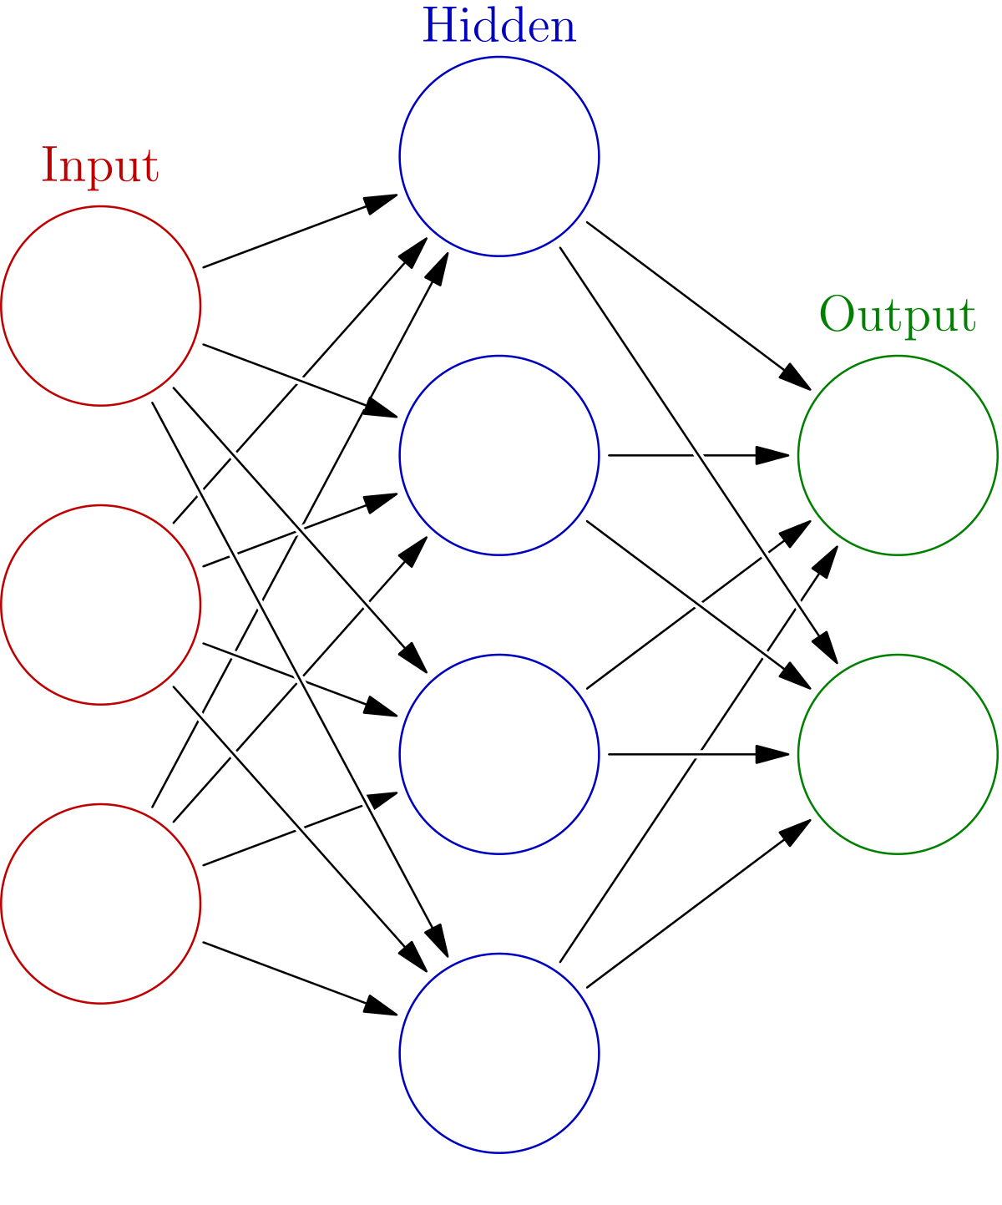
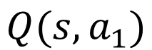
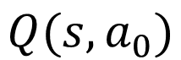
Deep Q Network (DQN) Mnih et al [4]
Given a state, the network computes the Q-Value for every action
Experiences are collected and used to train
3 layer neural network
Optimized with Mean Squared Error
$$Q(s,a_{0})$$
State
$$Q(s,a_{1})$$
Target
Prediction
Notes:
There is more to the algorithm explained in the paper but I will not explain them here to save time
loss is just a value that indicates how far our prediction is from the actual target
target = reward + gamma * np.amax(model.predict(next_state))

Slide 10
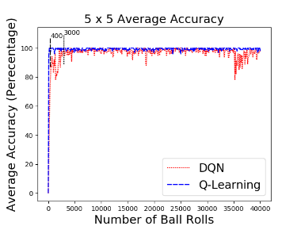
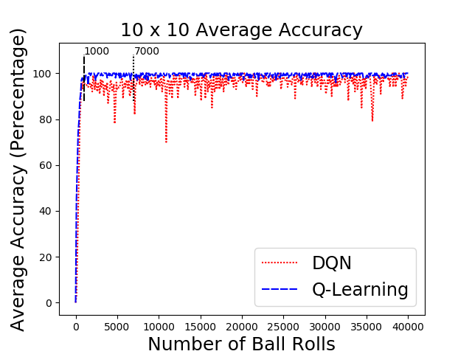
Results – Smaller State Space

Slide 11
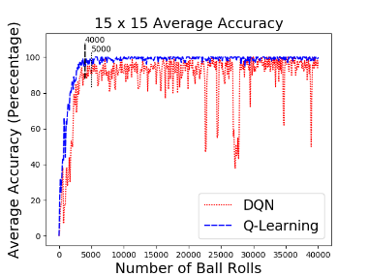
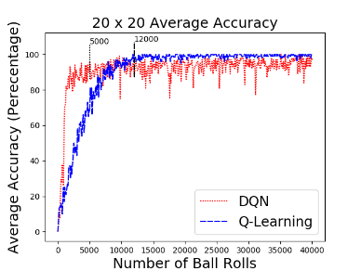
Results – Medium State Space

Slide 12
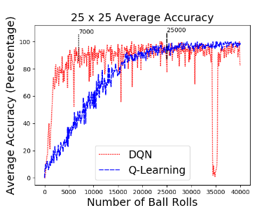
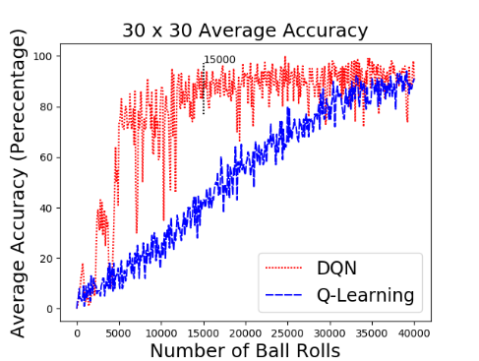
Results – Larger State Space

Slide 13
Conclusion
Environment discretization can enable simple physical tasks to become solvable with RL
Very limited state spaces, Q-Learning outperforms DQN
With an increased number of state spaces, DQN outperforms Q-Learning and converges more quickly

Slide 14
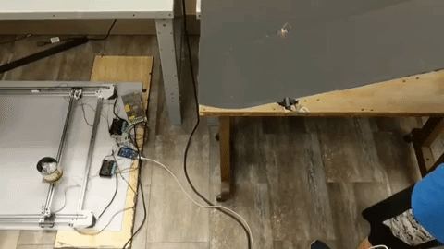
Future Work

Slide 15
References
[1] J. Kober, M. Glisson, and M. Mistry, “Playing catch and juggling with ahumanoid robot,” inHumanoid Robots (Humanoids), 2012 12th IEEE-RAS International Conference on. IEEE, 2012, pp. 875– 881.
[2] R. Lampariello, D. Nguyen-Tuong, C. Castellini, G. Hirzinger, and J. Peters, “Trajectory planning for optimal robot catching in real-time,” inRobotics and Automation (ICRA), 2011 IEEE InternationalConference on. IEEE, 2011, pp. 3719– 3726.
[3] R. S. Sutton, A. G. Bartoet al.,Reinforcement nlearning: An introduction.MIT press, 1998.
[4] V. Mnih, K. Kavukcuoglu, D. Silver, A. A. Rusu, J. Veness, M. G.Bellemare, A. Graves, M. Riedmiller, A. K. Fidjeland, G. Ostrovskiet al., “Human-level control through deep reinforcement learning,”Nature, vol. 518, no. 7540, p. 529, 2015.

Slide 16
Thank you! Question?

Slide 17
Real-World Projectile Catching with Reinforcement Learning: Empirical Analysis using Discretized Simulations
Bryon Kucharski, Adam Ziel, Michael Hickey, Collin Travers
{kucharskib, ziela, hickeym2, traversc}@wit.edu
Wentworth Institute of Technology
Real-World Projectile Catching with Reinforcement Learning: Empirical Analysis using Discretized Simulations

